Slide 1
SUMMARIZATION
OF VIDEOS
ADISHRI GUPTA
169105014

Slide 2
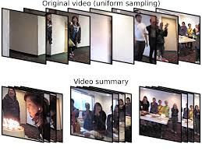
OBJECTIVE
Visual Data in the form of images, videos and live streams have been growing at an unprecedented rate in the last few years.
BLESSING -For the data scientists because it helps them improve predictive accuracy.
CURSE-It is a curse for humans because most of video taken by smartphones, surveillance cameras never end up getting curated and become redundant and boring to watch.
Video summarization would help the user to quickly grasp the important content of the video according to the requirement

Slide 3
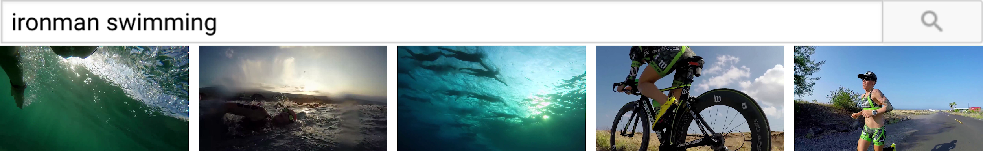
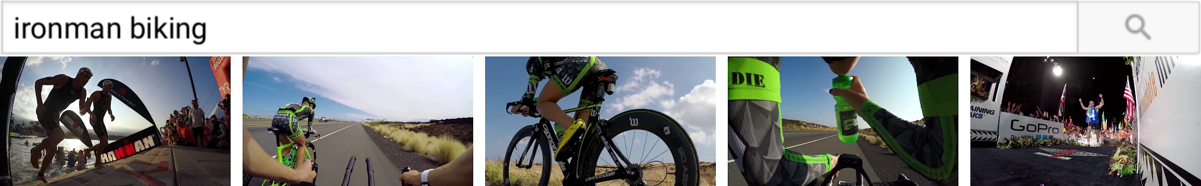
PROPOSED SOLUTION
My approach aims to combine the areas of TEXT-VISUAL embeddings and VIDEO SUMMARIZATION METHOD using submodular mixtures for creating summaries that are QUERY ADAPTIVE
The query-adaptive video summarization model picks frames that are relevant to the query while also giving a sense of entire video

Slide 4
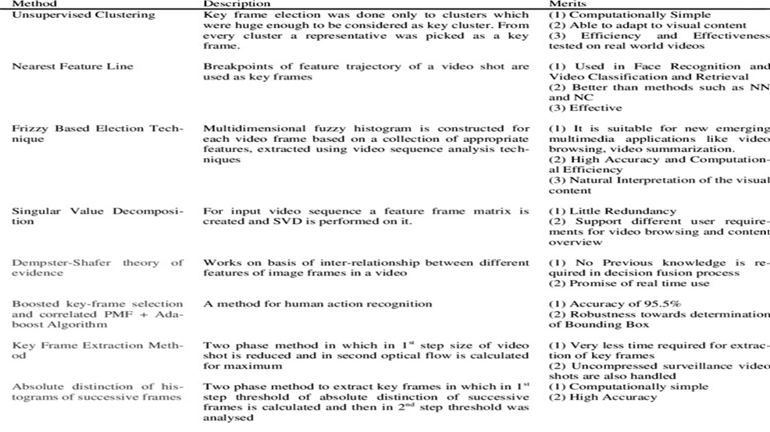
STATE OF ART
Most video summarization techniques can be categorized into methods trying to model one of three properties of summaries:-(i) interestingness (how good is a given snippet as a summary)(ii) representativeness (how well the summary represents the entire video or image collection)(iii) diversity (how non-redundant and diverse is the summary)

Slide 5
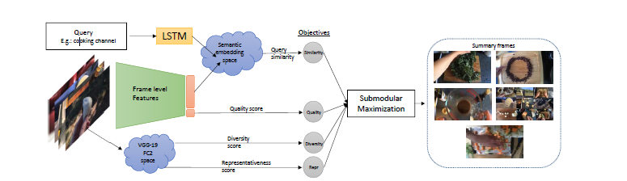
PROPOSED METHODOLOGY
Develop a relevance model which allows us to rank frames of a video according to their relevance given a text query.
Using the submodular framework of objectives for optimising the selected set of frames for diversity and representativeness.

Slide 6
HIERARCHY OF APPROACH
QUERY BASED SUMMARIZATION
QUERY RELEVANCE
PREDICTION
SUMMARIZATION
MODEL
TEXTUAL REPRESENTATION
IMAGE REPRESENTATION
SUBMODULAR SUMMARIZATION
FRAMEWORK

Slide 7
TEXT REPRESENTATION-A feature representation t of the textual query,first project each word of the query into a semantic space using the word2vec model which is trained on GoogleNews dataset.
IMAGE REPRESENTATION-To represent the image, we leverage the feature representations of a pre-trained VGG-19 network on ImageNet
SUBMODULAR SUMMARIZATION FRAMEWORK-
In this framework, summarization is posed as the problem of selecting a subset (in our case, of frames) y that maximizes a linear combination of submodular objective functions.

Slide 8
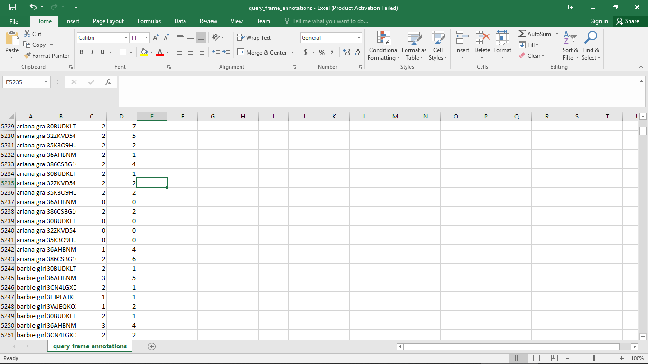
EXECUTED ACTIVITIES
DATASET
The dataset contains query relevance and diversity annotation which will be used to train and evaluate query-relevant summaries. It consists of 200 videos, each of which was retrieved given a different query
Relevance annotation ranges between 0 and 4 (Options for answers are “Trash”,“Not good”, “Good” and “Very Good”) for each frame.
Cluster annotations starts from 0 and ranges to an arbitrary number. 0th cluster indicates Trash frames and are of low quality

Slide 9
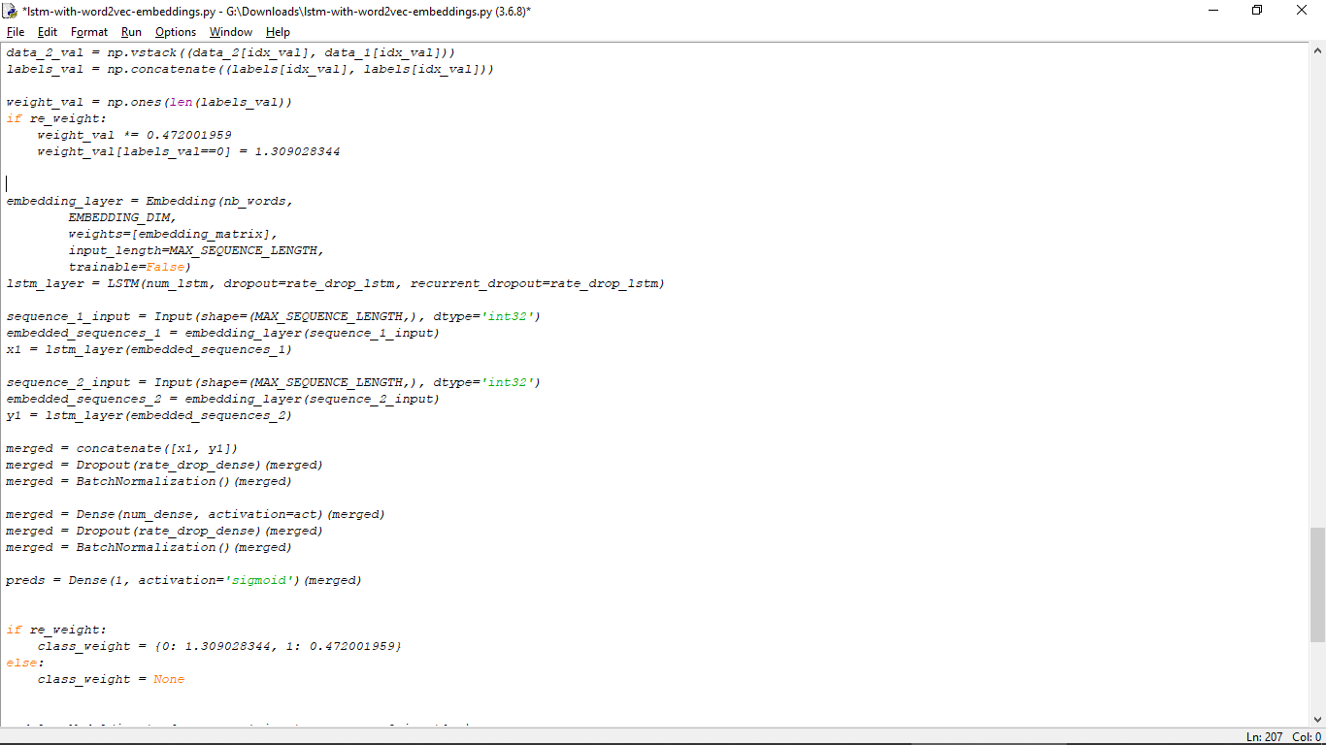
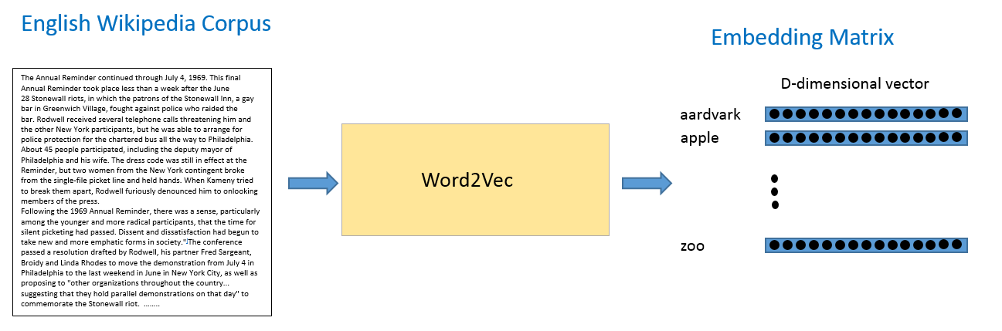
TEXT REPRESENTATION
The query would be encoded into a single fixed-length
embedding using an LSTM. This allows us to emphasize on
Visually informative words and handle phrases.

Slide 10
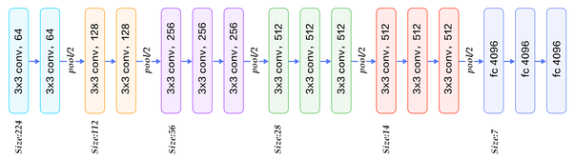
IMAGE REPRESENTATION USING VGG-19
APPLICATION:
Given image → find object name in the image
It can detect any one of 1000 images
It takes input image of size 224 * 224 * 3 (RGB image)
BUILT USING:
Convolutions layers (used only 3*3 size )
Max pooling layers (used only 2*2 size)
Fully connected layers at end
Total 16 layers
MODEL SIZE: 528MB
Pre trained model (Tensorflow)
Top-1 Accuracy: 70.5%
Top-5 Accuracy: 90.0%
VARIENT: VGG-19

Slide 11
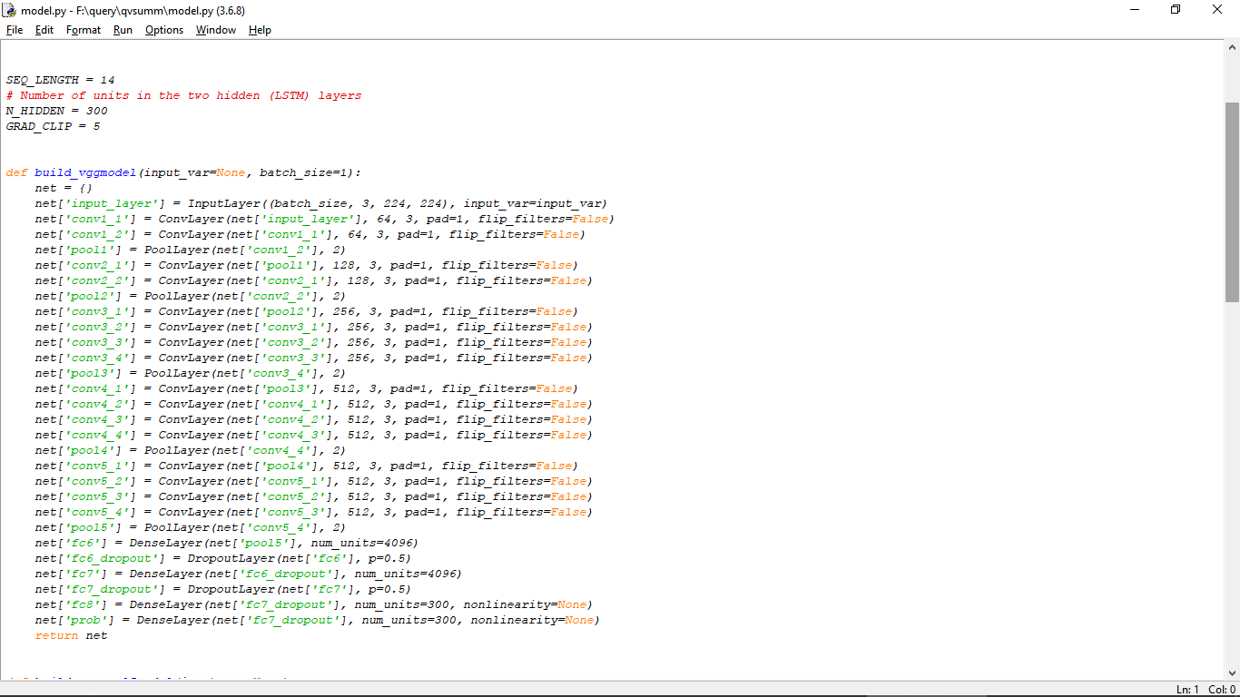
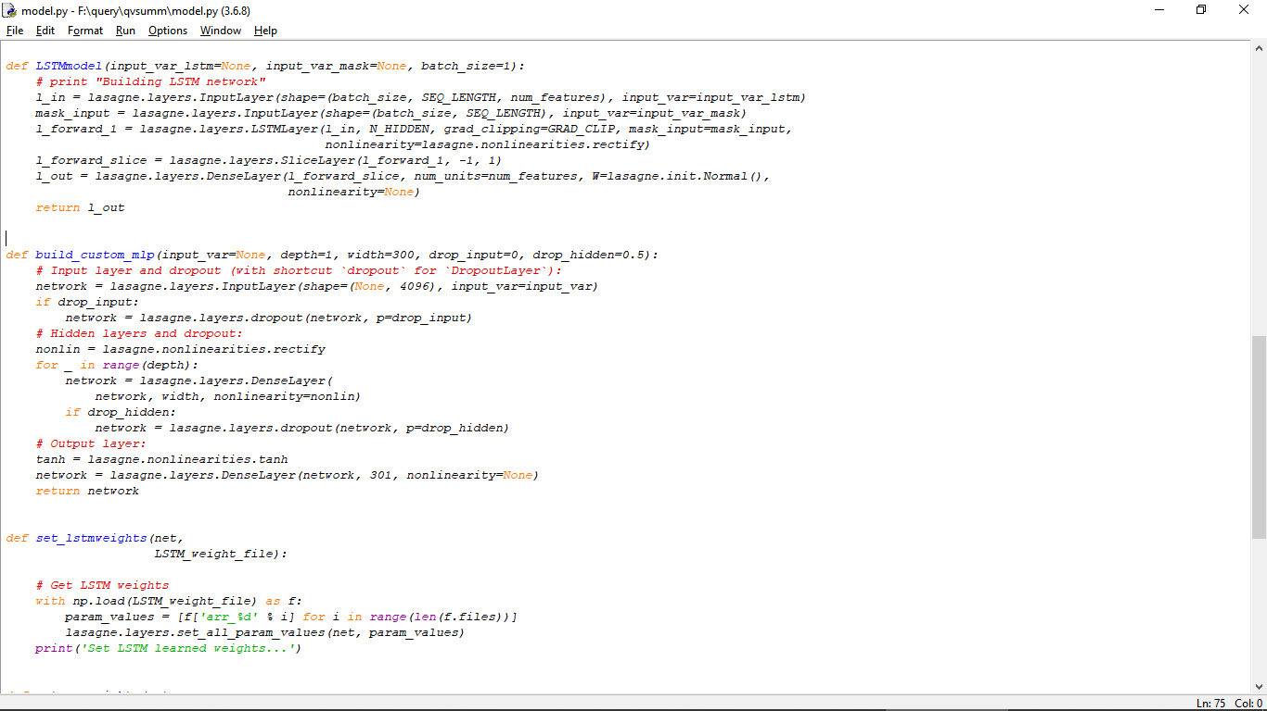
CODE SNIPPETS OF LSTM AND VGG-19 MODELS
A common LSTM cell remembers values over arbitrary time intervals.

Slide 12
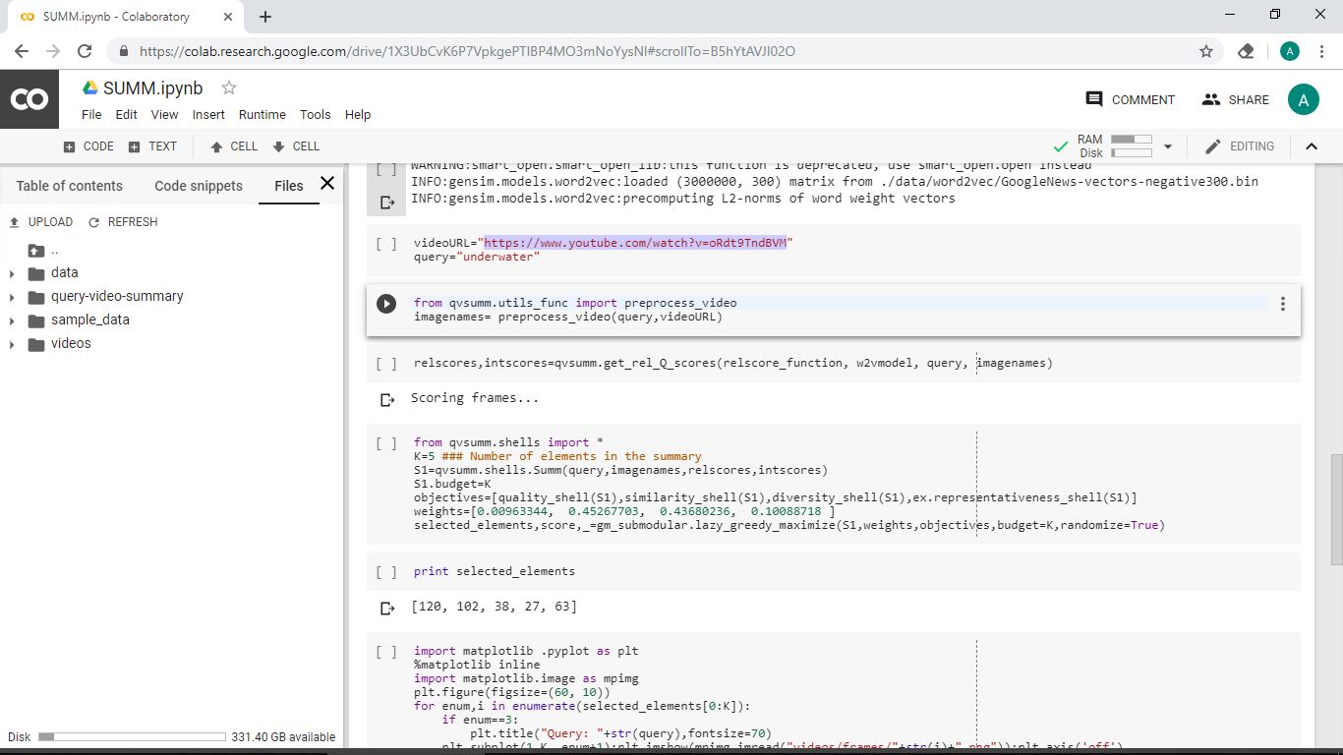
SUBMODULAR SUMMARIZATION FRAMEWORK
The framework of submodular optimization to create summaries that take into account multiple objectives . In this framework, summarization is posed as the problem of selecting a subset (in our case, of frames) y that maximizes a linear combination of submodular objective functions.
f(xv, y)=[f1(xv, y),………………………..fn(xv, y)]^T

Slide 13
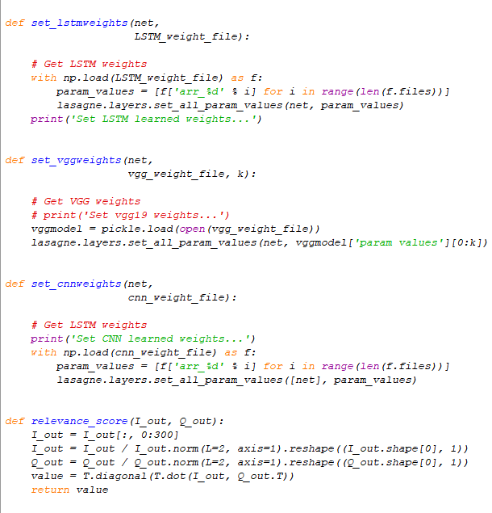
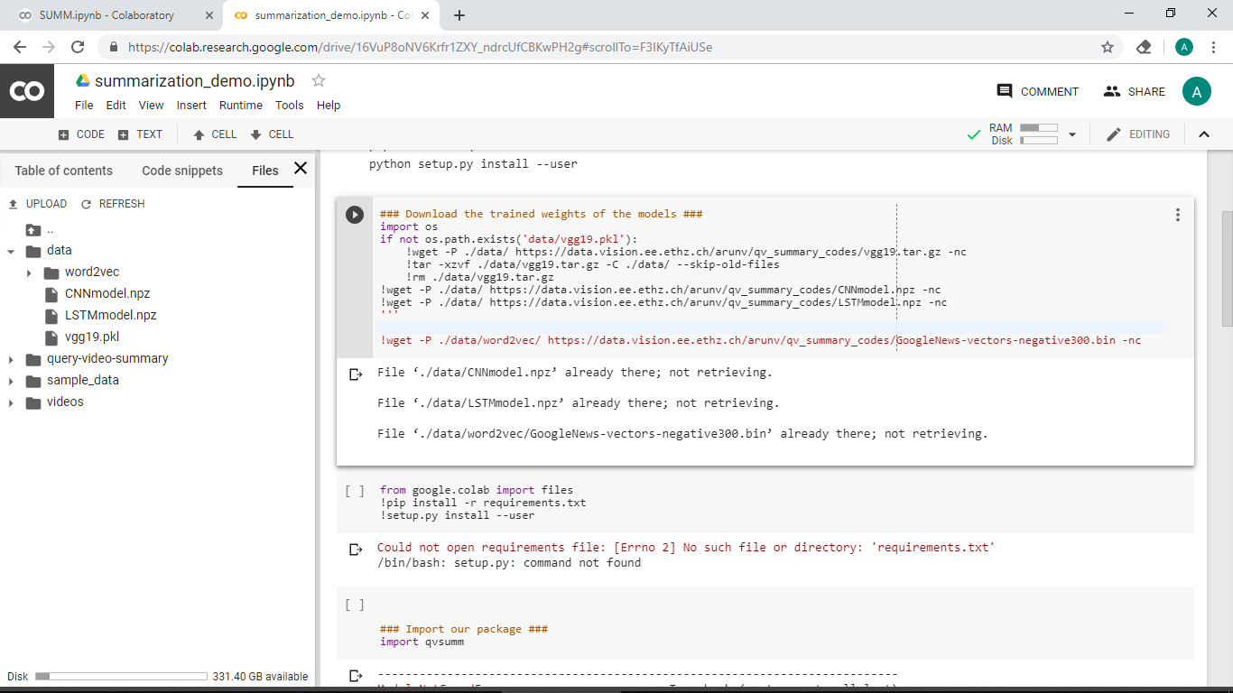
APPLICATION OF TRAINED WEIGHTS
The pre-trained models are trained on very large scale image
classification problems. The convolutional layers act as feature
extractor and the fully connected layers act as Classifiers.

Slide 14
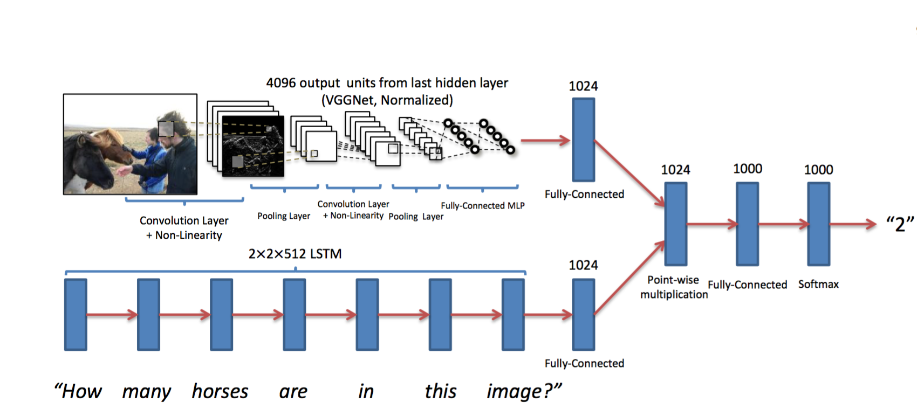
IMPLEMENTATION DETAILS
We split RAD into 100 videos for training, 50 for validation and 50 for testing.
We train for 20 epochs using minibatches of 128 triplets
We truncate the number of words in the query at 14, as a tradeoff between the mean and maximum query length
The annotation is in form of triplets (K,Q,C) meaning that the image K was clicked C times in the search results of the query Q

Slide 15
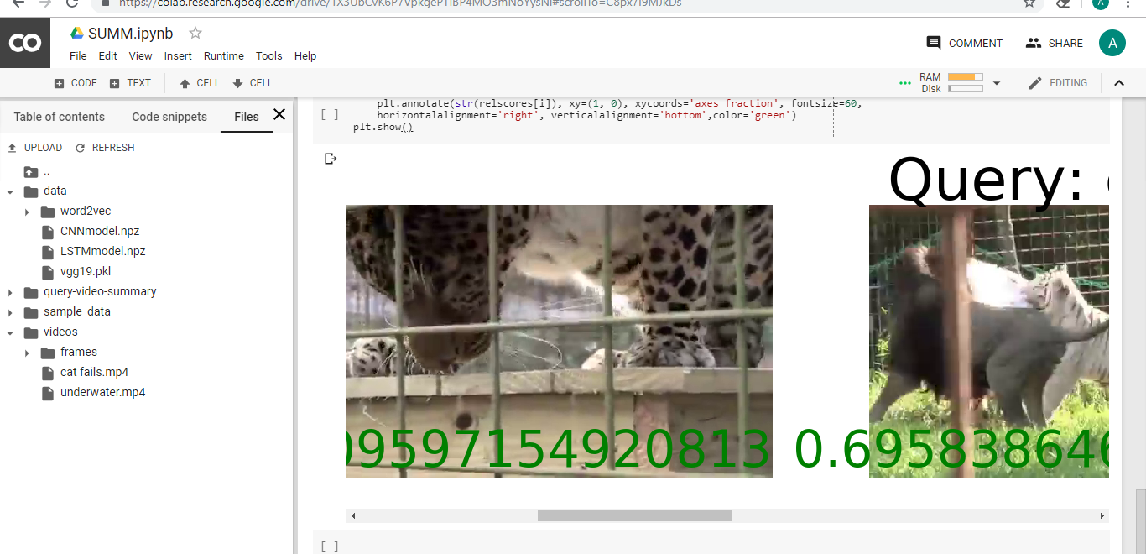
RESULTS
Combining all objectives of our model we get the following results. For a youtube video, and the query “cat fails” the following frames are extracted. We have determined that our objective, embedding queries with an LSTM and VGG-19 architecture for image classification might be suboptimal for predicting quality

Slide 16
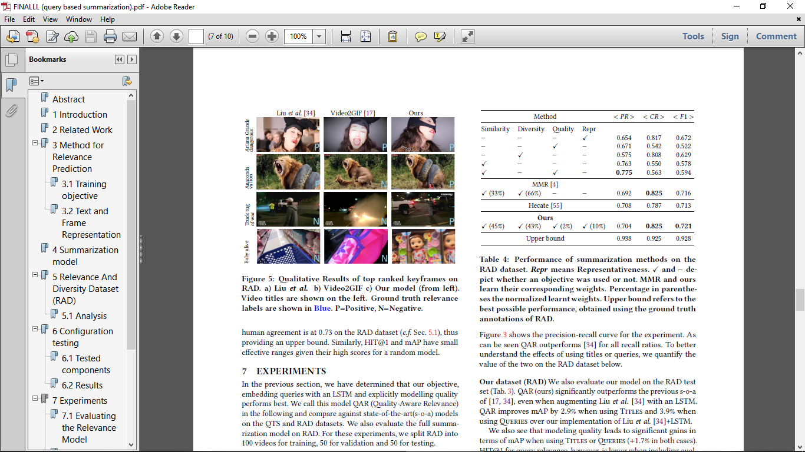
ANALYSIS OF THE RESULTS
Evaluation metrics-
The F1 score is the harmonic mean of precision of relevance prediction and cluster recall. It is high, if a method selects relevant frames from diverse clusters.
We determined that our objective, embedding queries with an LSTM and explicitly modelling quality performs best. We call this model QAR (Quality-Aware Relevance)
Precision-recall parameters for our model

Slide 17
TIMELINE
98%
98%
100%
95%
90%
1) RESEARCH PAPERS
2)MOOC COURSE
1)ANNOTATED DATASET
2)LSTM+CNN+SUBMODULAR FRAMEWORK FUNCTIONS
1)TEXT REPRESENTATION
2)IMAGE REPRESENTATION
3)FEATURE EXTRACTION
1)TESTING FOR EFFECTIVE SUMMARIZATION
1)REDUCING THE COST FUNCTION
2)IMPROVENTS IN PRECISON
RESEARCH
&
IMPROVISIONS
DATASET
&
APPROACH
APPLICATION
OF MODELS
TESTING
OF
THE MODELS
RESULTS
AND
ANALYSIS

Slide 18
THANK YOU

